Slide 1

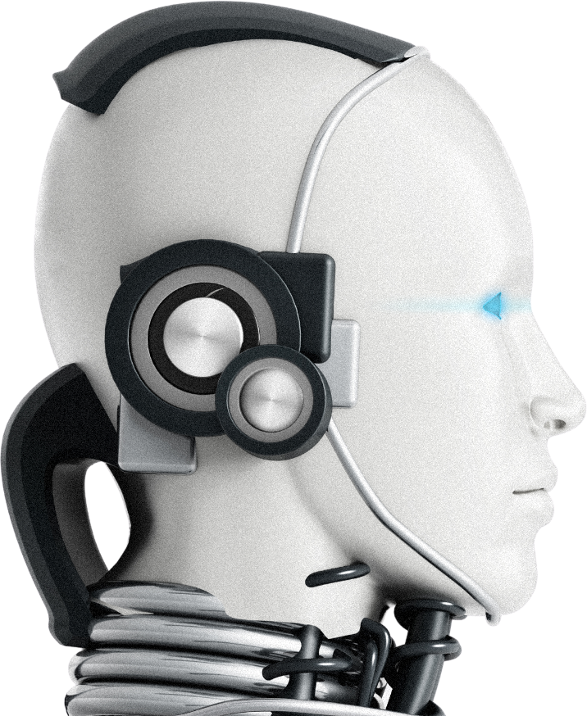
Artificial
Intelligence
Presentations are communication tools that can be used as demonstrations, lectures, speeches, reports, and more. Most of the time, they’re presented before an audience. It serves a variety of purposes, making them powerful tools for convincing and teaching.

Slide 2


Introduction
•Mission Statement: Tech Vaseegrah aims to innovate technology that empowers user experiences globally
•Vision for Growth: To become a leader in transformative tech solutions through sustainability and collaboration.
•Internship Goals: Empower interns with skills necessary for future tech industry leadership and innovation.

Slide 3

Project Overview
Streamlined Workflow: Enhances efficiency in audio processing by automating transcription and synthesis.
01
Improved Accessibility: Facilitates communication for users with hearing or speech impairments through AI-driven solutions.
02
Cost Reduction: Minimizes manual labor needs, lowering operational costs for businesses reliant on audio content.
03

Slide 4

Voice Recognition Complexity: Background noise, accents, and variances hinder accurate voice recognition systems.
Problem Statement
01
Data Processing Challenges: Real-time processing demands high computational resources, straining system capabilities.
02
User Intent Understanding: Distinguishing context and intent in commands remains a persistent challenge for systems.
03

Slide 5
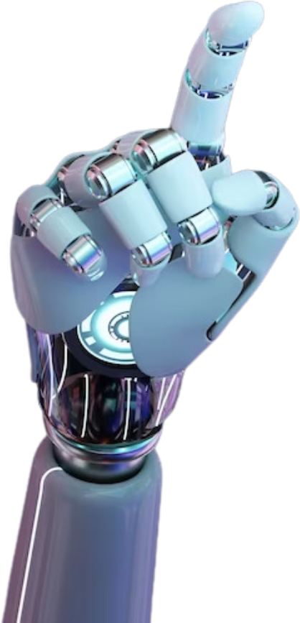
Project Objectives
Accuracy Assurance: Crucial for reliable text conversion, impacting overall user satisfaction and trust.
AI-Driven Insights: Utilizes natural language processing to enhance relevance of generated responses and interactions.
Scalability Potential: Adapts seamlessly to varying input volumes, supporting broader applications and user adoption

Slide 6

•OpenAI API Integration: Facilitates advanced natural language processing capabilities, enhancing user interaction quality.
•Whisper AI API Utilization: Enables robust audio transcription accuracy, crucial for inclusive communication solutions.
•Technical Interoperability: Ensures seamless collaboration between tools, optimizing overall system performance and efficiency.
Technology Stack

Slide 7
Project Implementation
•Audio Input Mechanism: Transforms user speech into digital signals for subsequent processing steps.
•Text Conversion Process: Employs machine learning algorithms to accurately transcribe audio into text data.
01
02
•Response Generation Technique: Utilizes AI-based models to formulate contextually appropriate replies from processed text.
03

Slide 8
Results and Outcomes
Time Efficiency: Reduces processing time significantly, enabling quicker responses and decisions.
01
Enhanced Productivity Metrics: Data indicates a 30% increase in overall project output due to automation.
02
Reduced Error Rates: Lowered inaccuracies lead to improved consistency and fewer correction cycles.
02

Slide 9

Challenges and Solutions
•Scalability Limitations: Encountered performance issues under high user load; optimized algorithms for improved throughput.
•Data Privacy Concerns: Ensured compliance with regulations through data anonymization strategies protecting user information.
•Cross-Platform Compatibility: Addressed integration challenges by developing modular interfaces for diverse operating environments.

Slide 10
Thank You

